Slide 1
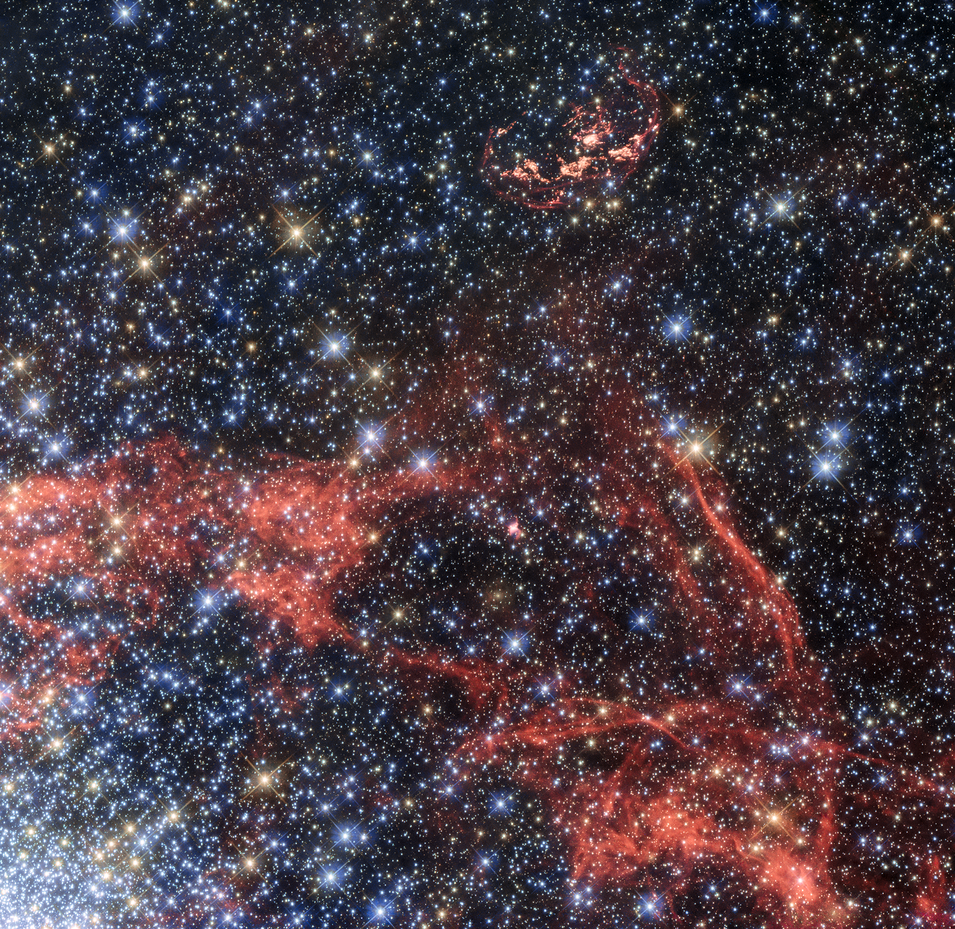




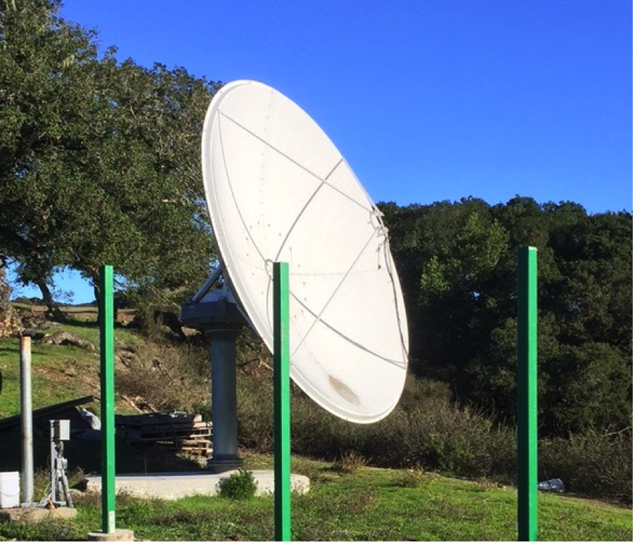
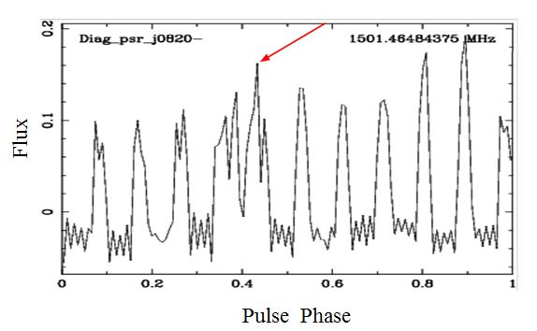
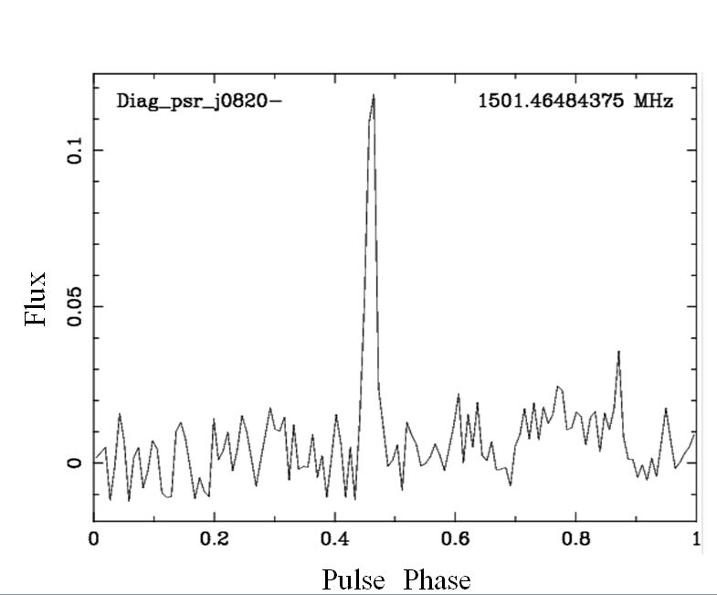
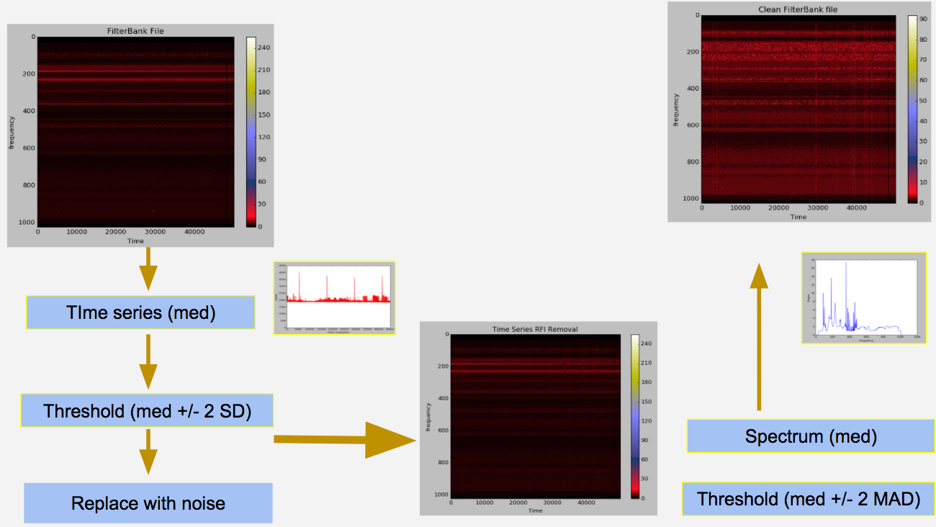
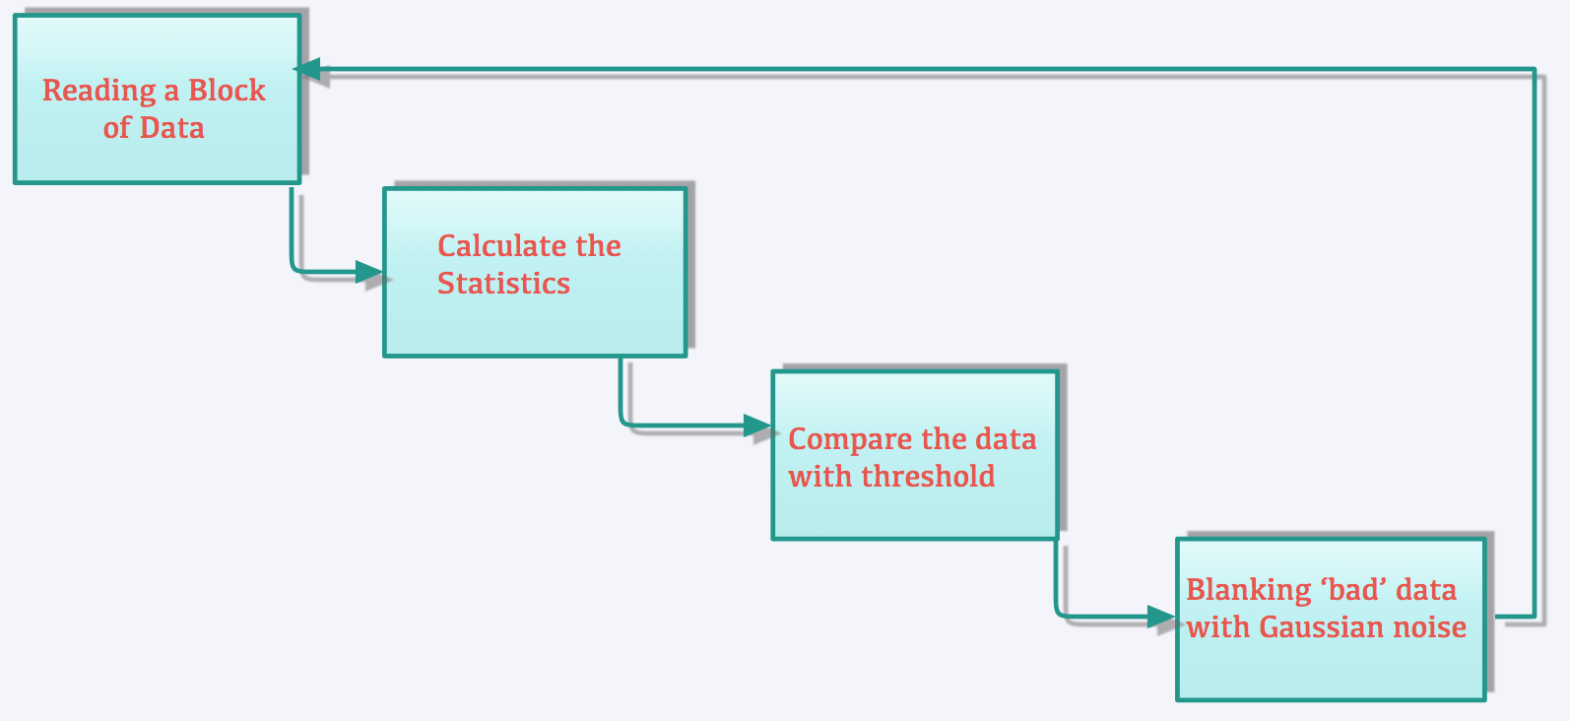
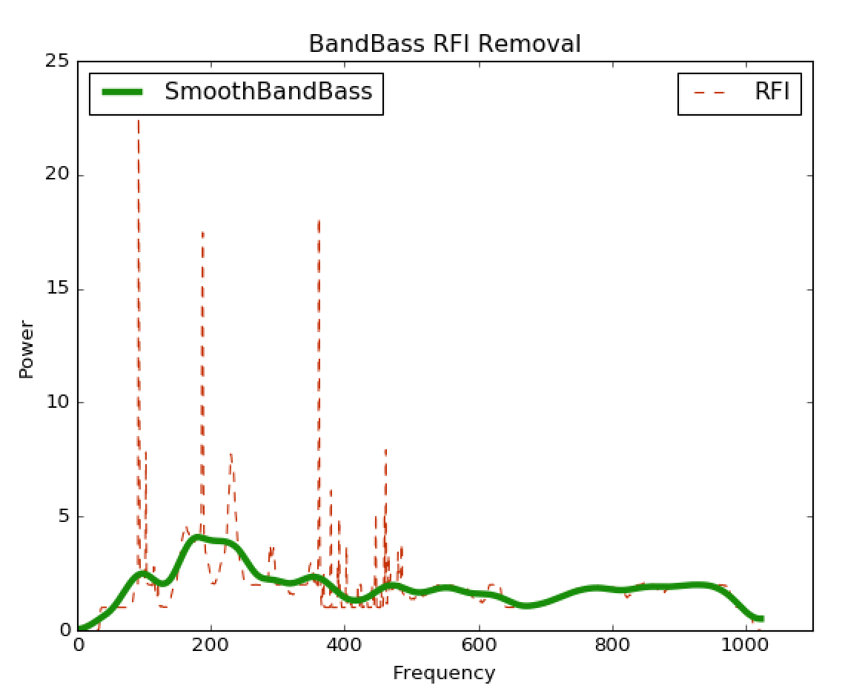
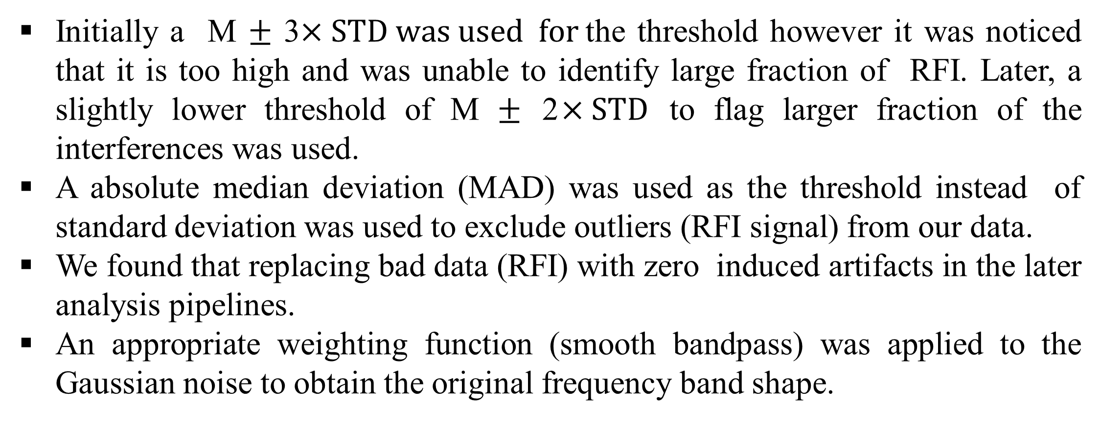
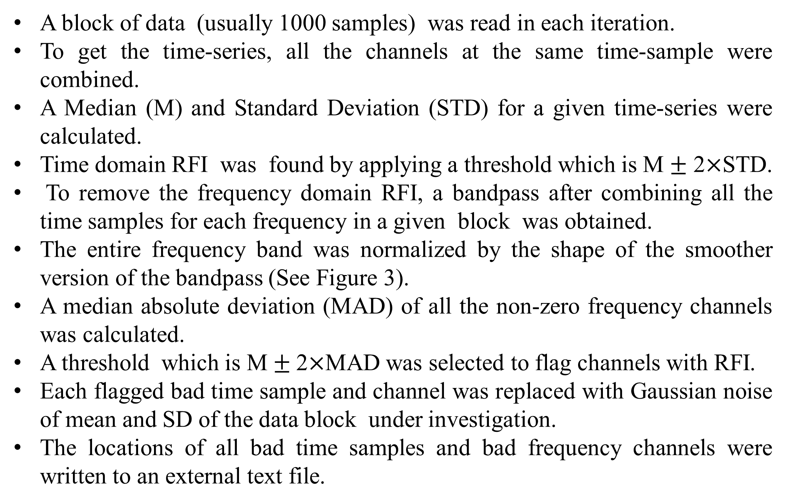
Software Pipeline for RFI Excision from Pulsar Data
Hasanain Alsabonchi, Dr. Vishal Gajjar, Dr. Dan Werthimer
Santa Monica College, UC Berkeley Space Science Laboratory
Abstract
The work reported here is on a Python-based pipeline to remove radio frequency interference (RFI) from pulsar data. The program is intended to read the data recorded from a radio telescope and then to calculate various statistics. A predefined threshold is applied (median$±2$ $×$STD for time-domain and median $±$ 2 $×$ MAD for frequency domain) to identify outliers in the data, to be then replaced with Gaussian noise from overall measured statistics. Such replacement helps us improve the signal-to-noise ratio of the pulsar profiles.
Introduction
Methods
Conclusion
A block of data (usually 1000 samples) was read in each iteration.
To get the time-series, all the channels at the same time-sample were combined.
A Median (M) and Standard Deviation (STD) for a given time-series were calculated.
Time domain RFI was found by applying a threshold which is M $±$ 2$×$STD.
To remove the frequency domain RFI, a bandpass after combining all the time samples for each frequency in a given block was obtained.
The entire frequency band was normalized by the shape of the smoother version of the bandpass (See Figure 3).
A median absolute deviation (MAD) of all the non-zero frequency channels was calculated.
A threshold which is M$±$ 2$×$MAD was selected to flag channels with RFI.
Each flagged bad time sample and channel was replaced with Gaussian noise of mean and SD of the data block under investigation.
The locations of all bad time samples and bad frequency channels were written to an external text file.
Figure 1: Leuschner observatory
With this project the UC Berkeley team is aiming to observe the Crab pulsar using the Leuschner radio telescope (Figure1) for at least a year in the frequency range 1.25-2.5 GHz. The Crab pulsar is known to occasionally emit giant pulses whose flux density is hypothesized to be a power law distribution. In order to detect these giant pulses, one must remove interference from the radio frequency data. Radio Frequency Interference (RFI) comes from signals of man-made artifacts. These can occur at the same frequency as the astronomical signals, which is a daunting task to truly differentiate them. In his project a Python pipeline (Figure 2) was developed to automatically remove the RFI from the data.
Figure 5: A single pulse from PSR B0820-13 at 1420 MHz with RFI
Figure 6: A single pulse from PSR B0820-13 at 1420 MHz after RFI removal
Figure 2: Overview of the pipeline
The above figure demonstrates that our pipeline is able to effectively remove Radio Frequency Interferences from the pulsar data.
Figure 4: Algorithm to remove RFI
Results
References
Initially a M $±$ 3$×STD was used for$the threshold however it was noticed that it is too high and was unable to identify large fraction of RFI. Later, a slightly lower threshold of M $±$ 2$×STD$ to flag larger fraction of the interferences was used.
A absolute median deviation (MAD) was used as the threshold instead of standard deviation was used to exclude outliers (RFI signal) from our data.
We found that replacing bad data (RFI) with zero induced artifacts in the later analysis pipelines.
An appropriate weighting function (smooth bandpass) was applied to the Gaussian noise to obtain the original frequency band shape.
Based on the "interference" entry of The Concise Oxford English Dictionary, 11th edition, online
Radio frequency interference / editors, Charles L. Hutchinson, Michael B. Kaczynski ; contributors, Doug DeMaw [et al.]. 4th ed. Newington, CT American Radio Relay League c1987.
Acknowledgements
The ASSURE program was funded by National Science Foundation under grant AGS-1461277.
I would like to thank Siuling Pau , Guillaume Shippee, Chenhui Niu, Deepthi Gorthi, and the Assure program for their valuable support in overcoming the many obstacles I encountered in the making of this project and this poster.
Figure 3: Smooth bandpass
For more information:
Hasananin Alsabonchi
hsadeveloper@gmail.com

